Slide 1
Need for space
Car racing simulator…. In space!

Slide 2
Elevator pitch
Fast supercars racing in amazing planets fighting for first place.
Customizable cars, new planets and a thrilling story!
100 of planets to race on!

Slide 3
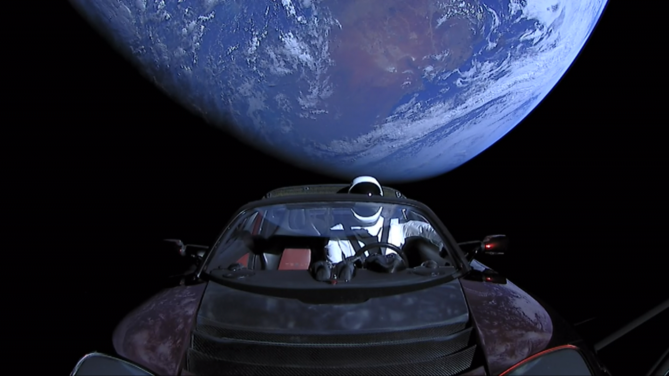
World background
The game is set in space, there are different galaxies and planets.
The players can visit planets to race on them and win prices and new cars.

Slide 4
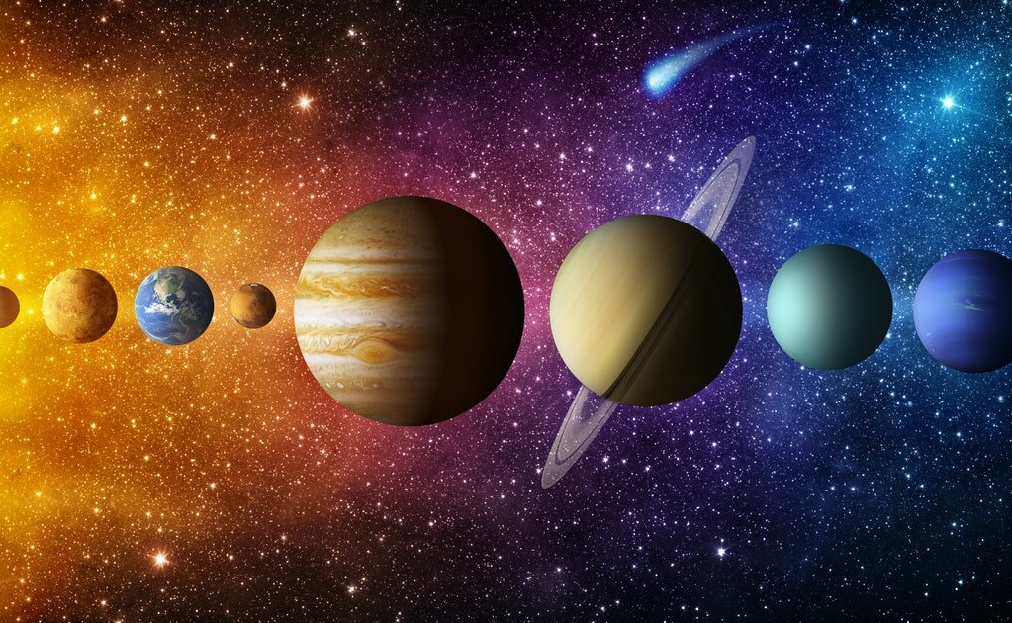
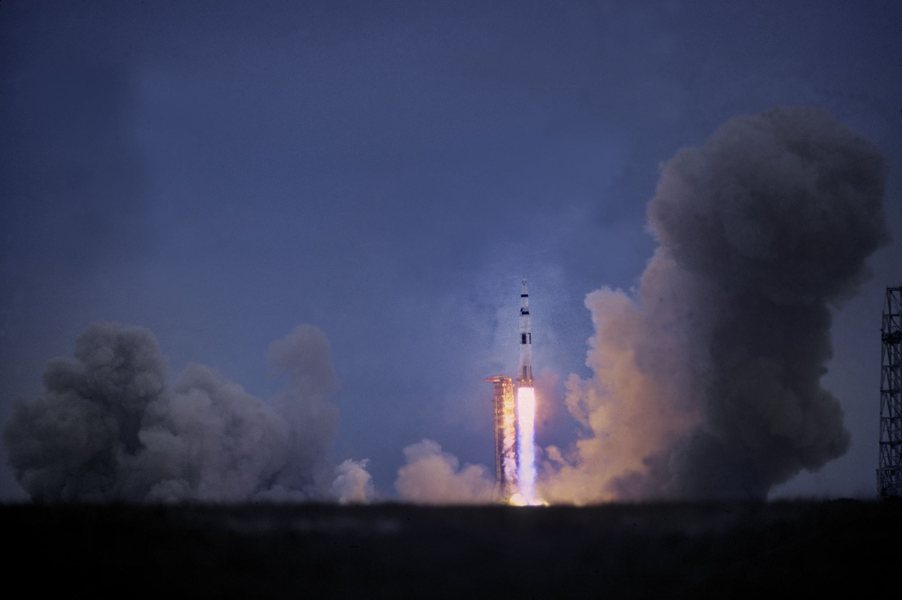
Feature Key points
The game will feature famous car racers
The player will be able to race on different planets
Player can explore space to find better parts for their car

Slide 5
Market Analysis
The game will be like all the typical racing games.
The customer will be people who love racing.
Expected sales 50 euro.

Slide 6
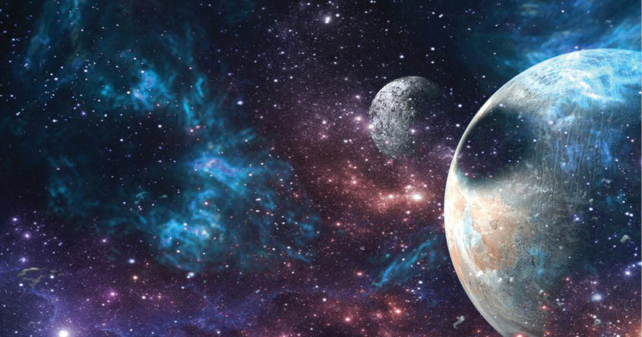
This game is about:
Racing through the vast beauty of space
Venturing to different planets in our solar system
Knocking other racers from the space roads into the vast abyss

Slide 7
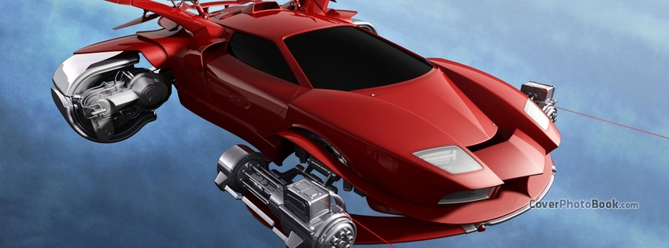
You race through space with cars

